Slide 1

Block coding Developer
Session - 31
Arithmetic Operators - 1

Slide 2

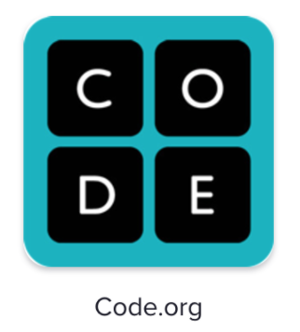
Recall…
What we have learnt in last session
What challenges you are facing

Slide 3
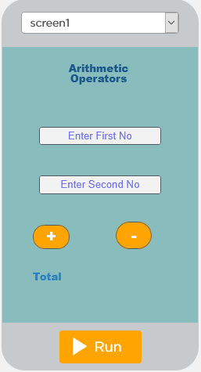
Arithmetic operators - 1
We will Learn today:
What is operator and operand?
What is Arithmetic operators?
What is variable?

Slide 4
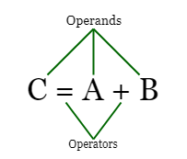
What is operator and operand?
Operators allow us to manipulate the variables and constants in the expressions.
Operands are the constants or variables which the operators operate upon Expressions.

Slide 5
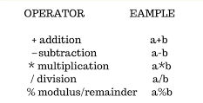
What is Arithmetic operators?
All programming languages support the basic arithmetic operations of addition, subtraction, multiplication and division of numbers
The addition operator is also used to add, or concatentate, two strings together

Slide 6
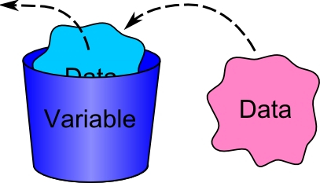
What is Variable?
Variables can only hold one value at a time
To store Values for use in programs

Slide 7

Addition and Subtraction
Calculating the sum of two number using a App Lab
First define two variable
First Value to be added or concatenated
Second Value to be added or concatenated

Slide 8
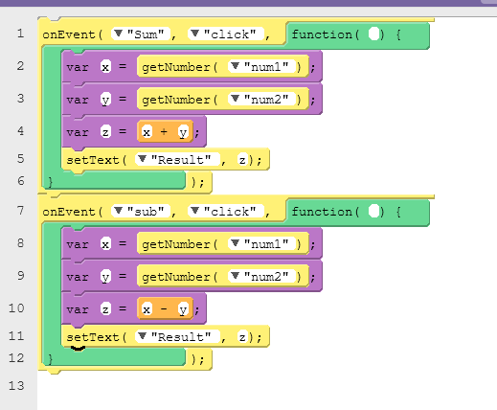
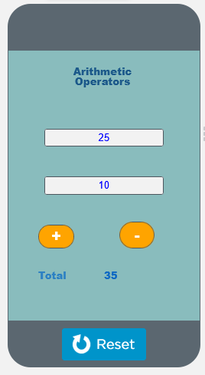
Example – Addition & Subtraction

Slide 9

Summary…
Operator and operand
Arithmetic operators
variable

Slide 10
Next Session…
Arithmetic operators
Write Multiplication code
Write Division code

